Slide 1
Modelling of Pulsating Post-flashover Compartment Fires
Modelling of Pulsating Post-flashover Compartment Fires
Charles Fleischmann & Po-Hao (Andy) Pan
Charles Fleischmann & Po-Hao (Andy) Pan

Slide 2
“Tell me a fact and I’ll learn. Tell me the truth and I’ll believe. But tell me a story and it will live in my heart forever.” Indian Proverb

Slide 3
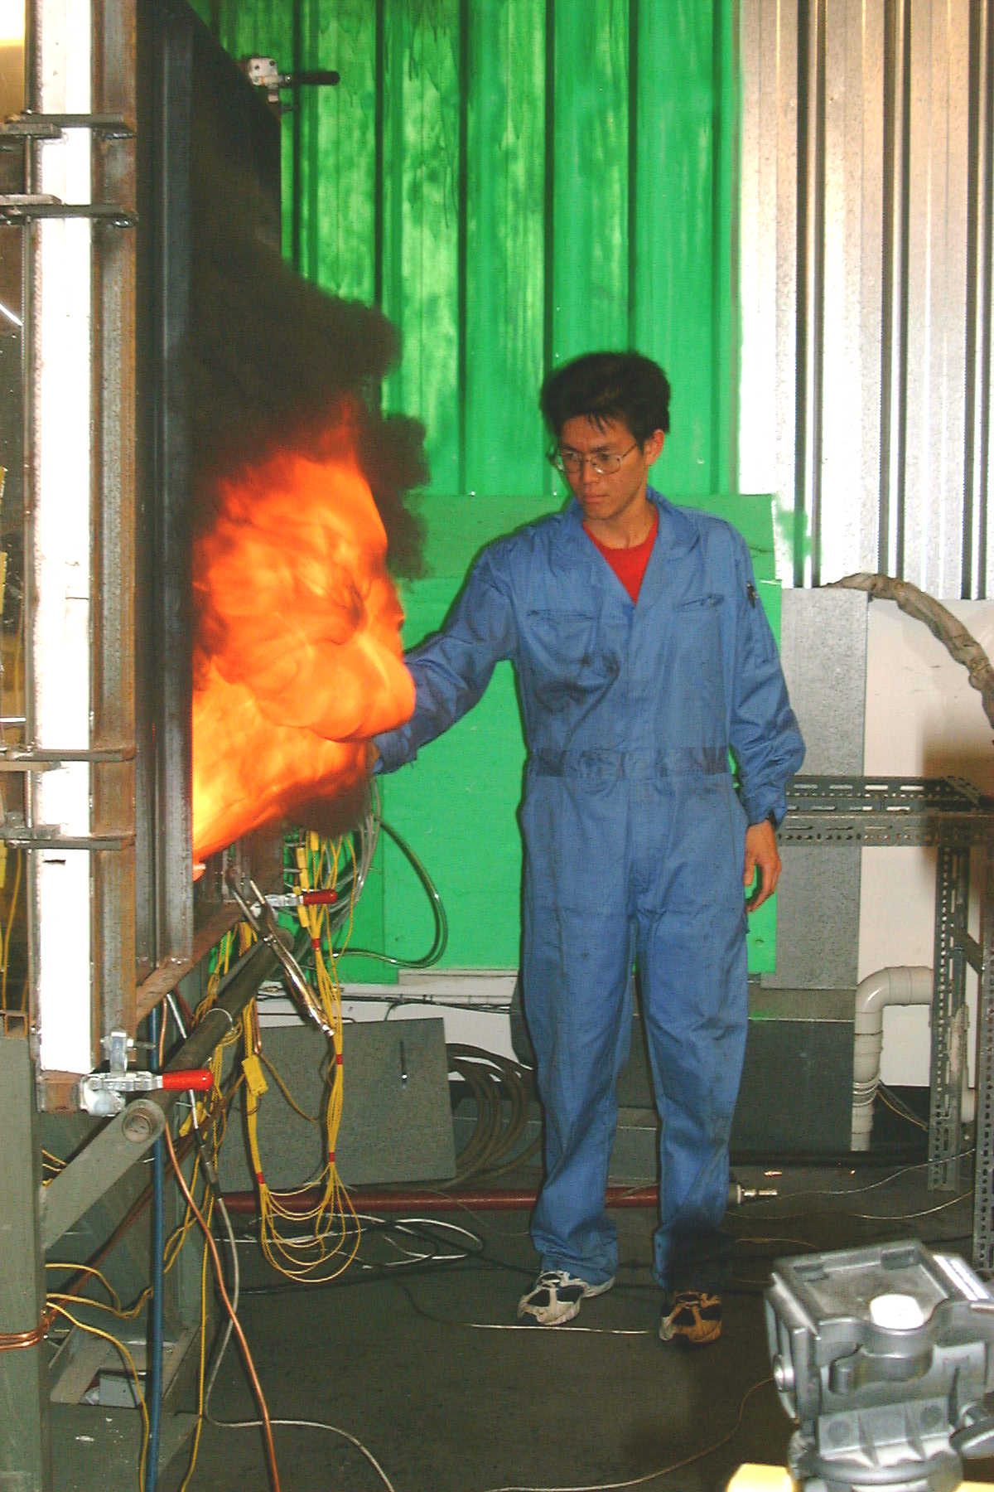
What is this story about
2001 - Experiments – Ee Yii
Post-flashover fire temperatures
Wanted to develop a simple model for compartments with wall vent and ceiling vent
Wanted to validate his model
Unexpected happened

Slide 4
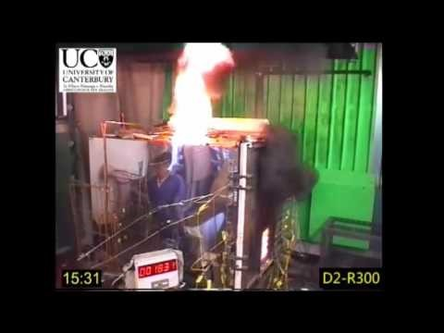
What is this pulsing

Slide 5
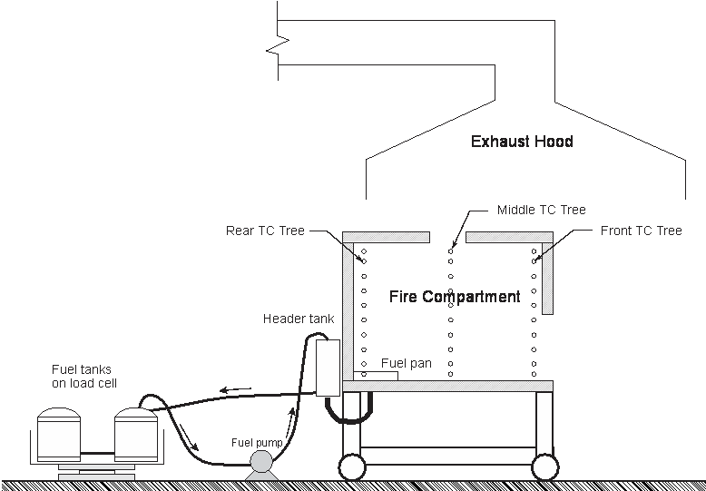
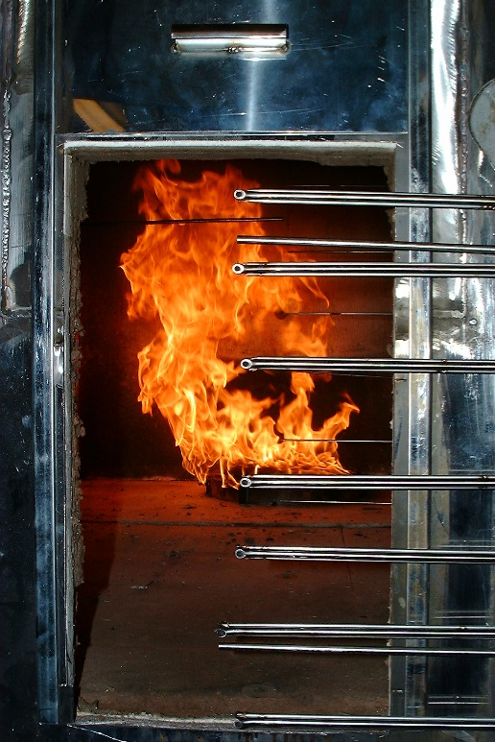
Yii’s experiments really detailed
Thermocouple trees
Vent flows
Mass loss

Slide 6
Vent sizes

Slide 7
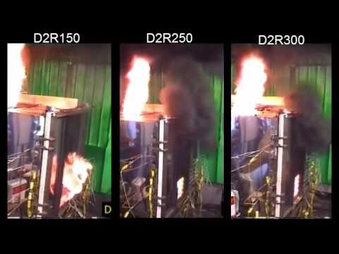
Obvious Pulsing Fires

Slide 8
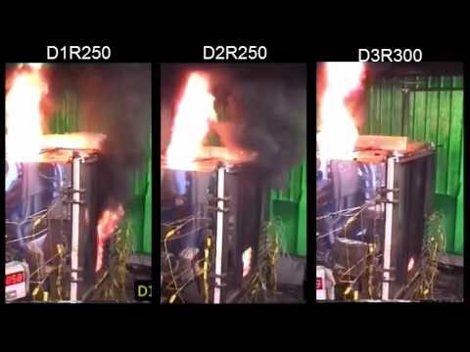
Not so obvious pulsing

Slide 9

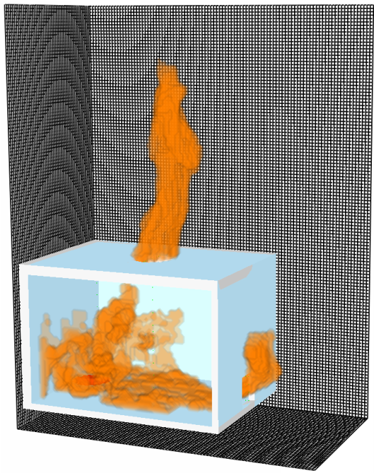
Modelling pulsating fire
Po-Hao (Andy) Pan - Masters research project
Modelled Yii’s experiments in FDS
Original work in FDS5
Delay
Work extended with FDS6

Slide 10
FDS Setup
Domain large enough to capture the external flames
Specified heat release rate for the fire.
No attempt to model the fire
Thermal properties carefully modelled.
25 frames/second for videos

Slide 11
Fire curves based on mass loss rate

Slide 12
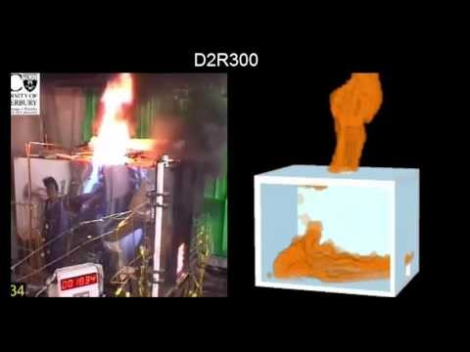
Typical pulsing in FDS

Slide 13
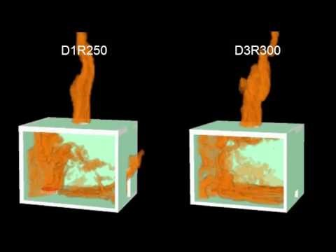
Pulsing near the limits

Slide 14
Quantative Results

Slide 15
Conclusions
FDS6 can model pulsing behaviour
Pulsing frequencies are within 20% of experimental results
Yii’s work could be more comprehensively modelled including analysing the compartment temperatures and vent flows?
Beyond the specified heat release used in this study, future work could look at predicting the heat release rate from the pool fire.

